Slide 1


Vision on digital
Frank Legters

Slide 2

Society challenges
Mobility
Energy
Healthy Living
Environmental impact
Climate resilience
Safety
Industry 4.0
….

Slide 3

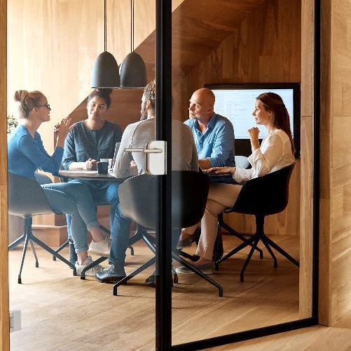

Client challenges!
  Growing populations lead to increasing demands
  People demand less negative impact on their environment
  Increasing societal responsibilities demand more transparency on reporting
  High ambitions on decarbonization increases the pressure on achieving results
  Involvement of stakeholders is increasing the complexity of the process
  Older people retiring create a lack of craftmanship
  Lack of resources

Slide 4

Digital ask
More parameters to manage
More algorithms wanted to grasp the craftmanship
Deeper search for optimalisation
Networks need to be connected to tackle the challenge
More finetuning needed to find the sweet spot
More certainty on outcome desired

Slide 5
Develop
Learning & Development
Coaching/Mentoring
Business Development
Innovation
Internal
RHDHV
External
Project management
QHSE
Account Management
Client surveys
Control

Slide 6
Develop
Learning & Development
Coaching/Mentoring:
Learn and stay ahead of the game
On demand training
Business Development
Innovation:
Improve hitrate (Setup/Volt)
Open new markets/clients (Reach, People Flows, Nebula)
Internal
Why digital?
Project management
QHSE
Automate instead of administrate (Sharepoint)
100% compliant easy
Find and recover
Automate the boring, focus on added value, increase fun factor (KES)
External
Account Management
Client surveys:
Improve collaboration with client (share systems)
Increase easy to work with feeling (A20)
Stay connected with client (iReport/Digital Twin)
Control

Slide 7
In relation to our current programs (examples)
 |  |  | Clients
 |  | DWOW
 | Project Excellence
Internal | Facilitating processes and software | Project-management | Collaboration with clients | Client solutions | Client operations | External
 | ABW, We Connect, DtW, PRS, QHSE | EDMS, Box, Sharepoint, Naming convention | Teams, DataFusr | GIS,Volt, Setup, Parametric Modelling, Automated Bridge Design, Fast Lane, Nebula, Castor, etc. | Aqua Suite, Flowtack, iReport

Slide 8
BU DC & DS
client setting
Develop
Novius
Data
Solutions
Domain
BLs
Internal
External
Control

Slide 9
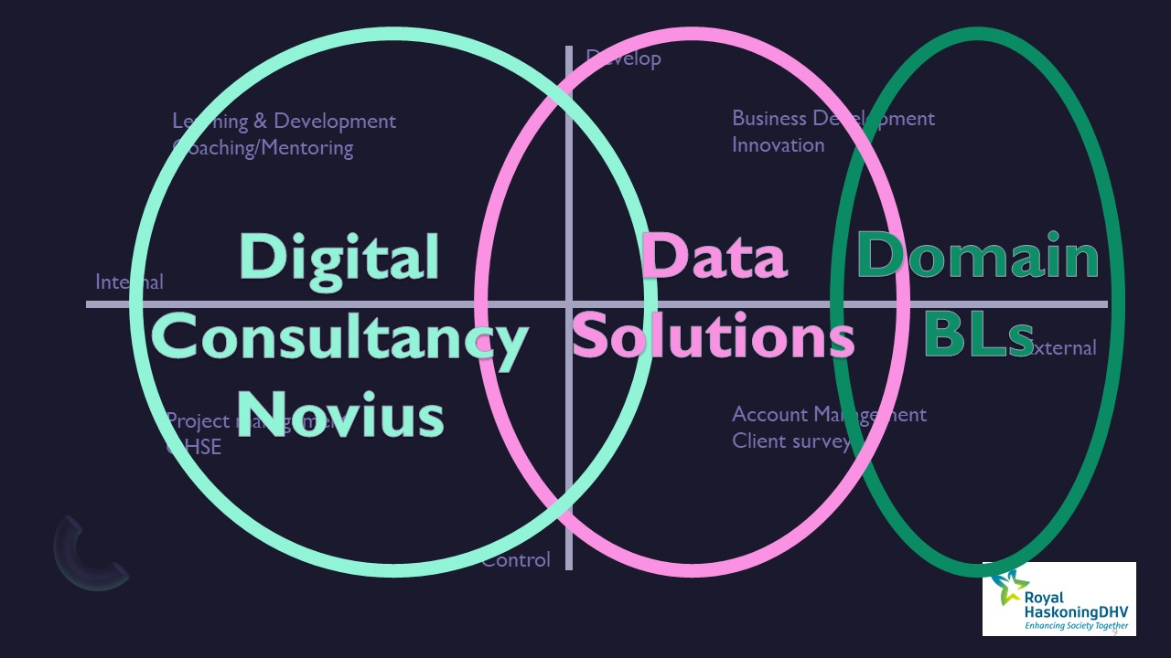
Software
Scalable, repetitive
BUS domain
Software as entry point to new clients for Domain BLs
Scalable, repetitive

Slide 10
What does this mean for our marketing?
85% will be led by the domain BLs
When BU DC & DS is involved we like to add the digital edge and value to the message
Domain BLs should feel enforced by the digital message to their clients
15% will be digital marketing messages to digitally oriented client groups (like SAM)
Marketing message starts with the Domain challenge written by our domain expert
Angelique will work closely together with the marketing teams of the domain BLs
In this we support the branding of our company as digital future ready.

Slide 11
Vision on digital
Frank Legters

